Slide 1
2024 Overview
Data Context
What’s new in 2024?
Different types of context clues you in to how to better understand your data. Understanding context will help you better craft the framework necessary to extract your data.
The newest Grooper version represents a new frontier in Grooper’s evolution. New AI based features accelerate Grooper design and capture.

Slide 2
New and Improved Functionality
Committed to web development
WINDOWS CLIENT REMOVAL
GROOPER COMMAND CONSOLE
UI IMPROVEMENTS
EFFICIENCY IMPROVEMENTS
LLM Integrations
AI EXTRACT
CLAUSE DETECTION
AI ANALYSTS &
DOCUMENT CHAT
Document search and retrieval
AI SEARCH INTEGRATION
THE SEARCH PAGE
NEW WAYS TO PROCESS CONTENT
Notes:
Click 1 – All topics

Slide 3
Committed to Web Development
Web app advantages
The Grooper web client has several advantages:
Deployment: Easier to deploy for larger environments with multiple client machines. Easier to scale in cloud-based architectures.
Scalability: Hardware needs for end users is minimal.
Security: Fewer users need access to the Grooper database and file store. Further security principles are easily managed with Grooper Permission Sets.
Development: Web based design opens Grooper up to new development possibilities and more efficient development.
Notes:
Grooper 2022 Grooper web client implemented for Review tasks
Grooper 2023 Grooper web client implemented for Design
Grooper 2023.1 Improved scripting support for web client
Grooper 2024 Thick client removal

Slide 4
Windows Client Removal
Goodbye Grooper thick client!
Removing the Windows client will allow Grooper to grow as a web platform.
All thick client functionality has been replaced by the web client or a new admin application called “Grooper Command Console”
Thick Client App | Replacement
Grooper Dashboard | Batches page
Grooper Attended Client | Tasks page
Grooper Design Studio | Design page
Grooper Config | Grooper Command Console (GCC)
Unattended Client | The “gcc services host” will host Activity Processing services in-process
Grooper Desktop | Installed on workstations but now configured in Scan Viewer
Notes:
Grooper 2022 Grooper web client implemented for Review tasks
Grooper 2023 Grooper web client implemented for Design
Grooper 2023.1 Improved scripting support for web client
Grooper 2024 Thick client removal

Slide 5
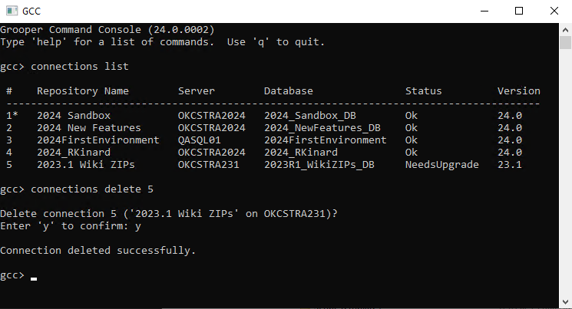
Grooper Command Console
Example: Inspecting the list of Grooper Repository connections and deleting one of them with GCC
GCC is the new Config
Grooper Command Console (GCC) is a command-line replacement for Grooper Config
Most admin functions are accomplished with one or few commands
Commands can be easily scripted
Scaling services is much easier
Notes:
The big difference here. What takes several clicks in a point and click UI is done with a few text based commands in command line interface
Can procedurally execute functions previously done in Grooper Config with simple command line scripts. (You can execute GCC from Windows Command Prompt btw)
While we’ve poc’d deploying Grooper in Docker containers it’s GCC that’s really going to let us do it.

Slide 6
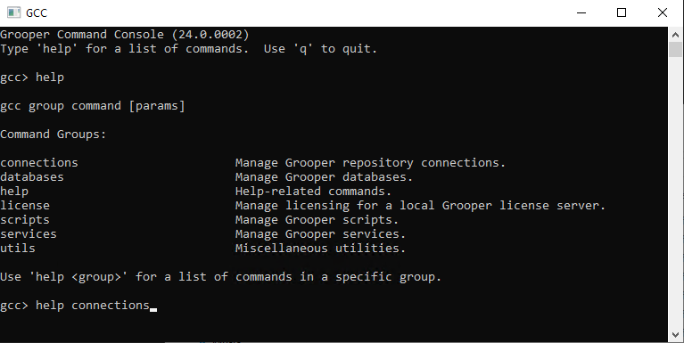
Grooper Command Console
Command groups
help
connections
databases
services
license
scripts
utils
Tip: Enter “help” to list the command groups.
Tip: Enter “help <group>” to list commands for that group.

Slide 7
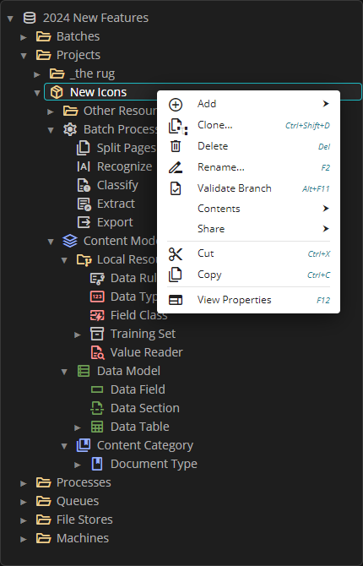
UI Improvements
New icons!
The older WinForms PNG icons have been replaced with vector graphic icons. This has both aesthetic and practical reasons.
Matches our current design better.
Vector graphics scale better to screen resolution/zoom settings.
Easier to adjust and create new icons.
Nodes of similar types are color coded in the node tree for easier identification

Slide 8
Efficiency Improvements
New Database Table: BatchState
Pre 2024, the Batch management UI gets slow when a large number of Batches exist in the system.
Why? We can’t query the Grooper databases efficiently
In 2024, we’ve prototyped a new database table: “BatchState”
Contains one row for every Batch
Allows fast, efficient Batch querying

Slide 9
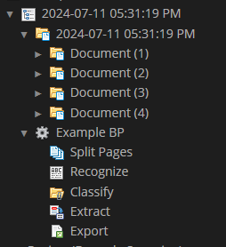
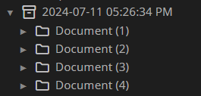
Efficiency Improvements
Before 2024
Simplified Batch architecture
Historically, every Batch has a child copy of a Batch Process
Very inefficient
Duplicates nodes in the tree unnecessarily
Particularly inefficient when processing small Batches
In 2024, Batches will reference published processes, rather than cloning them.
Each published version of a Batch Process is archived in the Processes branch.
Batches are now much more lightweight.
After 2024

Slide 10
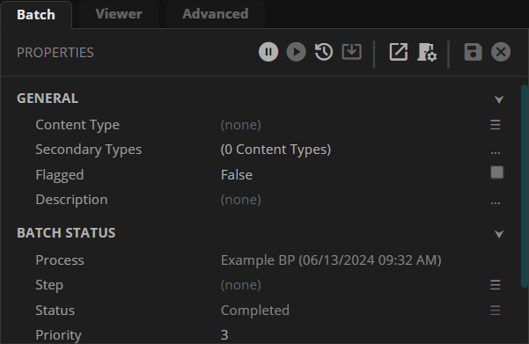
Batch Redesign
New suite of testing tools
“Go To Process” button
As an effect of this redesign, you can’t test Batches using the local copy of a Batch Process.
A new suite of testing tools has been added to replace and supplement this style of testing:
Selecting a published Batch Process, you can test Batches in the Production branch.
Production Batches have a “Go to Process“ button. This will navigate to the Batch’s referenced process and set that Batch in the Activity Tester
Published Batch Processes now have a “Batches” tab. This will show a list of all production Batches currently using the Batch Process.
Referenced Batch Process

Slide 11
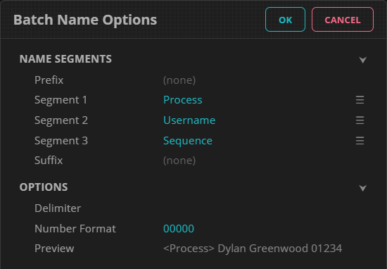
Batch Redesign
Bonus! Batch “Name Options”
Traditionally, imported Batches get named with a timestamp and an optional prefix.
Users now have more options: A prefix, a suffix and one to three “segments”
Segments may be one of the following:
Sequence
DateTime
ContentType
Username
Machine
BatchId

Slide 12
LLM Integrations
LLMs and Grooper
What are LLMs?
LLM stands for Large Language Model. They are a type of neural network that is highly capable of natural language processing.
OpenAI’s ChatGPT utilizes LLMs as the foundation of their chatbot technology.
What are LLMs used for in Grooper 2024?
Automated data capture at scale.
User-directed data capture or repair.
Ad-hoc research and discovery.
What LLMs can I access in Grooper 2024?
OpenAI public cloud services (GPT models)
Azure cloud services (including OpenAI’s GPT models and other LLM models like Llama and Mistral)
Private-hosted OpenAI clones
Notes:
LLMs are the future of nature language processing AI. Most well known LLMs are OpenAI’s GPT models.
Grooper is committed to incorporating current AI technologies in this and all future versions.

Slide 13
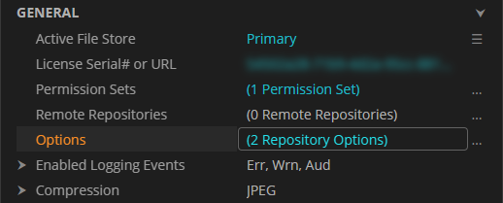
LLM Connectors
Repository Options: LLM Connector
New “Repository Options” set at the Grooper Root enable repository wide features.
“LLM Connector” option defines connections to LLM web servers by adding one or more “Service Providers”.

Slide 14
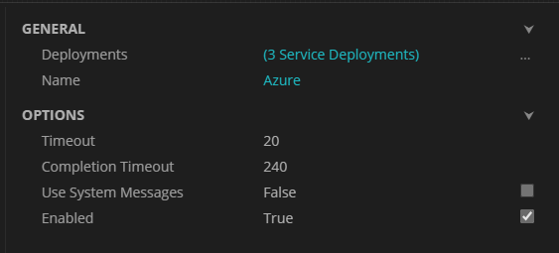
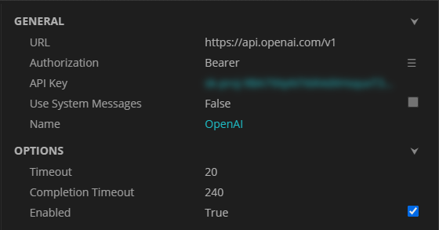
LLM Connectors
LLM Service Providers
Currently, there are two Service Provider types.
Open AI – Connects to OpenAI web servers or privately hosted OpenAI clones
Azure – Connects to chat or embeddings endpoints available in Azure
The Azure provider uses the Azure Machine Learning service
Configured to point at one or more Azure “Service Deployments”
Azure LLM Provider config panel
Azure Service Deployments config panel
OpenAI LLM Provider config panel
The OpenAI provider is configured with a base URL and API key.
FYI: The URL property defaults to OpenAI’s base API URL
Each Service Deployment represents an endpoint which hosts the chat or embeddings API.
Each Service Deployment is associated with a specific model.
Several LLM models can be found in Azure’s “Model Catalog”
Ex: OpenAI, Azure OpenAI, Llama, Mistral AI and more
Notes:
We have used an application called LM Studio to host OpenAI clones. This allows use of GPT models on private servers.

Slide 15
LLM Constructs
Major LLM constructs in Grooper 2024
Ask AI. Replaces the outdated GPT Complete extractor. Can parse JSON responses and generate named groups, making it suitable for use with sections and tables.
AI Extract. LLM-based data extraction populates sections, tables, and fields with near-zero configuration effort.
Clause Detection. Natural language search based on LLM embeddings allows clauses to be detected in natural language contracts.
AI Analysts. Create task-specific LLM chatbots and which assist humans in navigating through document content and extracting information.
Notes:
LLMs are the future of nature language processing AI. Most well known LLMs are OpenAI’s GPT models.
Grooper is committed to incorporating current AI technologies in this and all future versions.

Slide 16
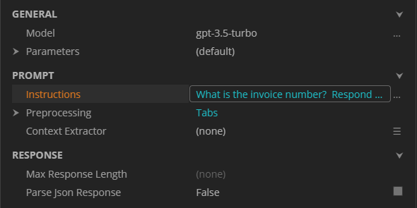
Ask AI
An updated LLM extractor
Ask AI’s property grid
“Ask AI” is a new Extractor Type.
It is a replacement for the now outdated “GPT Complete”
GPT Complete uses a deprecated method to call the OpenAI API.
“Ask AI” can be used with any LLM Service Provider.
“Ask AI” has other advantages over “GPT Complete”
The basic idea is the same: Prompt an LLM chatbot with a question about a document to return a result.
New capability! “Ask AI” can parse JSON responses into a Data Model’s instance hierarchy. This means you can use “Ask AI” as a Row Match table extractor.
Questions/prompts are entered in the “Instructions” editor

Slide 17
Ask AI
Ask AI strengths and limitations
PROS
CONS
Returns data using a natural language prompt.
Less knowledge of Grooper extractors required to return data
Quicker time to value.
Easier to maintain over time.
LLM responses can be unpredictable.
LLM responses can be inaccurate.
LLMs answer by predicting the next best word one after another. They do not “know” anything.
As an extractor, “Ask AI” must be configured “per field”.
An API call is made every time the extractor executes.
No result highlighting*

Slide 18
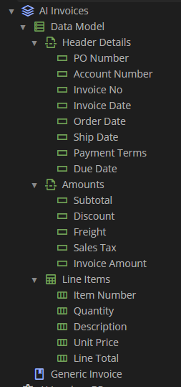
AI Extract
More Data. Less Work.
To overcome some of the limitations of Ask AI, we created a new LLM construct: “AI Extract”
The Big Idea: Use an LLM to extract data by simply describing the data to be extracted.
Let the Data Model be self-descriptive.
The AI should “know” what to extract based on how Data Elements in the Data Model are named.
Allows Grooper to extract a Data Model with a fraction of the set up.
No need for hand-crafted extractors.

Slide 19
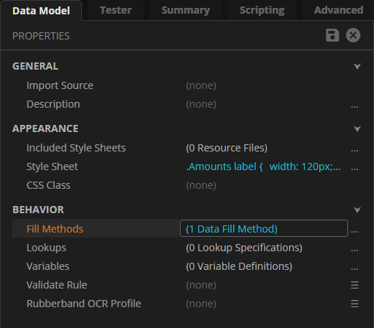
AI Extract
AI Extract: The first “Fill Method”
“AI Extract” is the first “Fill Method” in Grooper.
Fill Methods can be configured on “container” Data Elements
Data Models, Data Sections and Data Tables
Be aware: “AI Extract” currently has no known on a Data Table.
Fill Methods are secondary extraction operations which populate child Data Elements. They run after extraction.
Ex: A Fill Method is set on a Data Model.
First, all its child Data Elements run their configured Value Extractors and Extract Methods.
Then, the Fill Methods runs. It can be configured to overwrite extraction results or only fill blank fields.

Slide 20
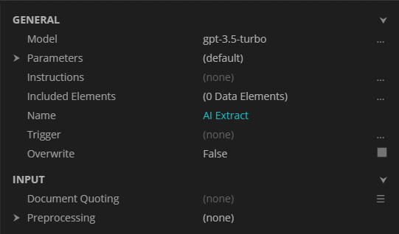
AI Extract
Make LLMs do the work
AI Extract’s property grid
Minimal configuration is required to start getting data back.
In many cases, well-named Data Elements are all that is required.
If necessary, Descriptions are added to Data Sections, Data Tables, and Data Fields as needed to specify special instructions.
How it works:
Prompts the LLM with some document content.
Asks the LLM to generate JSON matching the Data Element structure.
Parses the resulting JSON data into sections, tables, and fields.

Slide 21
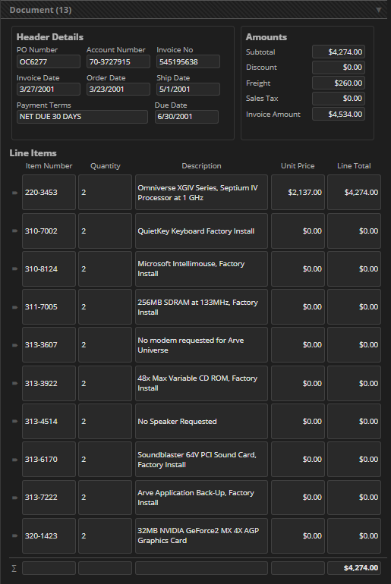
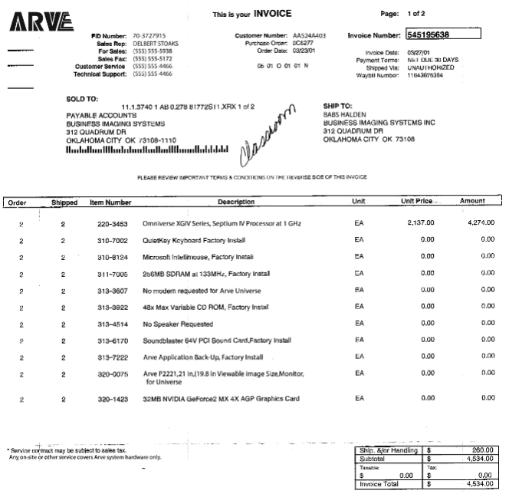
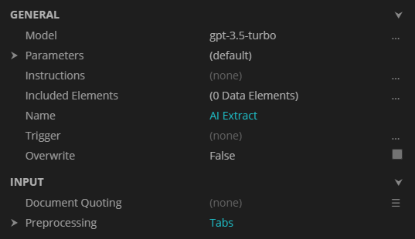
AI Extract
AI Extract example
Notes:
Example invoice on the left.
Target Data Model on the right
AI Extract configured on Data Model
Default Settings (plus tab marking) gets complete extraction

Slide 22
AI Extract
AI Extract strengths and limitations
PROS
CONS
Instant time to value.
Ease of use is off the charts. Just define the Data Model and go.
Fills in a full Data Model with fewer API calls than Ask AI
Has some result highlighting (defined by “Alignment” settings)
LLM responses can be unpredictable.
LLM responses can be inaccurate.
Easy to become over-confident when using this. There are always errors when you look closely.
Larger documents pose more of a challenge to fully extract.
Slower than traditional Grooper extractors (particularly for larger documents).
Result highlighting is not perfect.
Notes:
Current mechanism is limited by context length (the text you feed into the prompt)

Slide 23
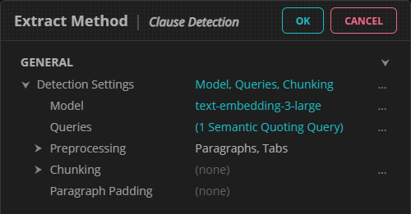
Clause Detection
Simpler clause detection
New Data Section Extract Method: Clause Detection
Uses LLM embeddings to detect clauses in natural language documents.
Simplest mechanism to locate domain specific text on legal documents yet.
Configured by entering one or more examples of the clause.
Can be combined with an AI Extract Fill Method to great effect.
Clause Detection’s property grid
Notes:
AI Extract was originally designed for natural language documents (contracts).
It was honestly surprising how well it ended up working for more structured and semi-structured documents.
Important to note this is a “detection” mechanism and not an “extraction” mechanism. This will mechanism will more often than not give you more than just the clause you’re looking for, but the clause will be contained within the larger text. This narrows down the context for subsequent AI Extract or traditional extraction passes.

Slide 24
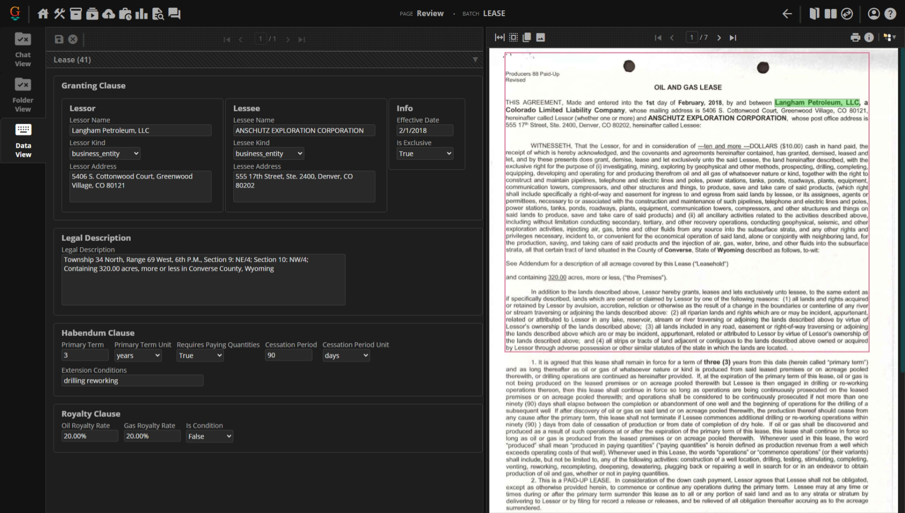
Clause Detection
Example results

Slide 25
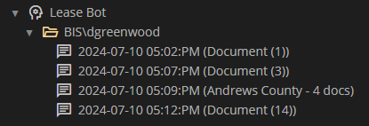
AI Analysts & Document Chat
AI Analyst
Chat with your documents
AI Analyst is a new node type that spins up a document chatbot.
It defines a task-specific LLM assistant used to chat with documents.
Selecting one or more documents, users can chat with the assistant in Grooper about the selected documents.
Text data from the selected documents are fed into an assistant’s knowledge base.
Knowledge files are divided into chunks.
Embeddings are stored for each chunk.
As users enter questions, an embeddings-based search finds chunks of document content relevant to the question and feeds them into the context.
Each chat is stored as a child Chat Session organized by user.
archived Chat Sessions
Notes:
Potentially, this mechanism allows users to have a conversation with a Batch or file containing hundreds or even thousands of documents

Slide 26
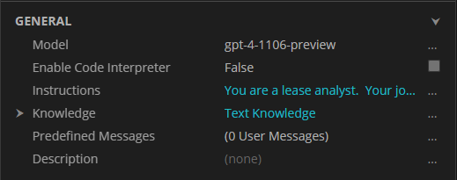
AI Analysts & Document Chat
AI Analyst setup
AI Analysts’ property grid
Like other LLM constructs, the AI Analyst setup is minimal.
Most important part are the “Instructions”
Example Instructions for an oil and gas lease analyst:
You are a lease analyst. Your job is to answer questions about oil and gas lease documents, to assist a human lease analyst in sorting through the content of a lease file.
Your knowledge files contain the text content of one or more documents taken from a lease file. Each page of content is separated by a form feed character. When responding, please reference source material and include short verbatim quotes which can easily be linked back to the original knowledge content.
Notes:
Currently there is only one type of “Knowledge” and that’s “Text Knowledge”. In the future we may incorporate something like “data knowledge” to chat using the content of extracted Data Elements.

Slide 27
AI Analysts & Document Chat
How to start chatting
The “Discuss” command: The most ad-hoc method. Select documents in Batches to chat with from Design or search for them using the Search page.
The “Chat Viewer” in Review: Add a “Chat View” to a Review step to chat with the whole Batch or single documents.
The “AI Dialogue” activity: Starts an automated chat session. The activity asks questions predefined on the AI Analyst and saves responses to the Batch or each document. Responses can later be reviewed from a Chat View in Review.
Notes:
Ad-hoc: Good for document research.
In Review: Good for review users who need help understanding a document or finding information
AI Dialogue “gets the conversation started” Asks common question and/or prompts it with necessary information to understand the document set.

Slide 28
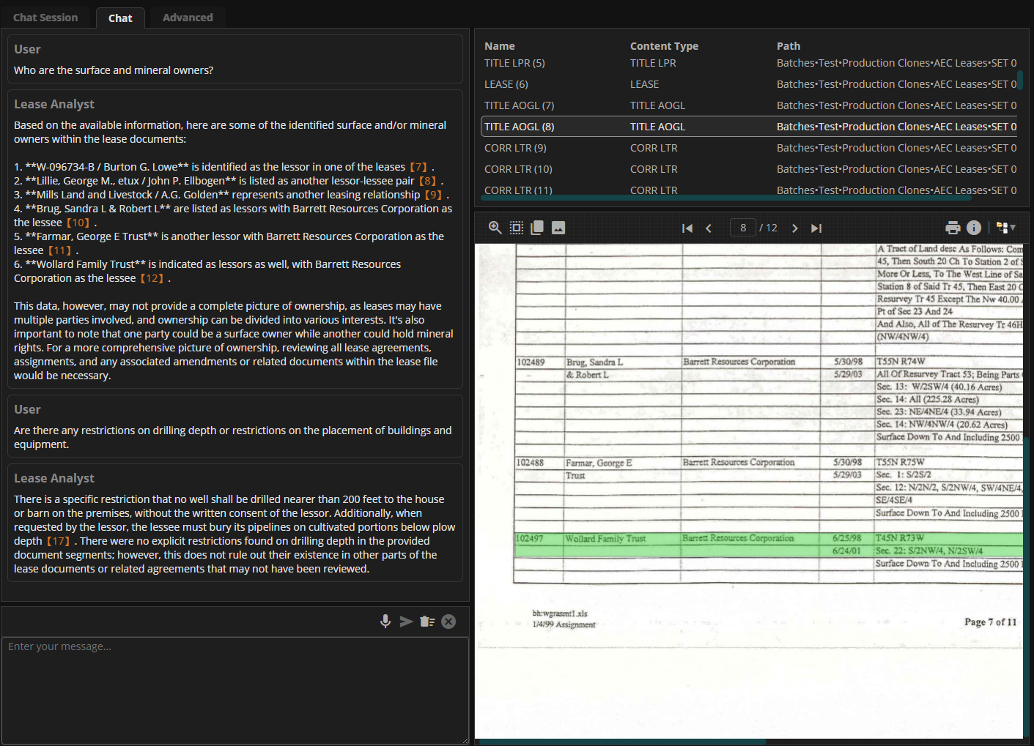
AI Analysts & Document Chat
The Chat Viewer
Displays a chat session on the left with documents on the right.
Chat questions are entered in the bottom of the left panel and answered above it.
The orange footnotes are references back to the source content.* Can be clicked to navigate to the source document in the Document Viewer
The Chat Viewer is accessible in four ways:
After using the “Discuss” command
From Review as a Viewer tab
From an existing Chat Session node’s “Chat” tab (to continue a chat)
Using the Chat page (to continue a chat)
Notes:
What does chatting with your documents look like?
*Footnotes require some additional setup in the instructions. You have to tell the AI Analyst to respond with “quotes” that can be linked back to the original knowledge content.

Slide 29
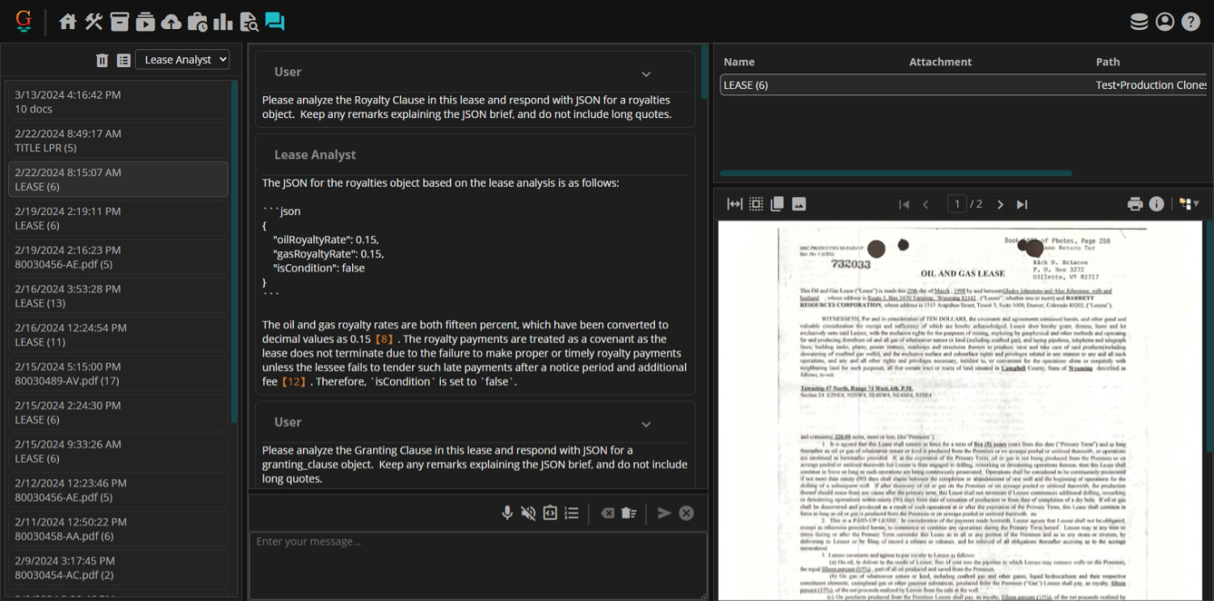
AI Analysts & Document Chat
The Chat Page
Allows users easy access to previous chat conversations.
Users can select an AI Analyst to view and continue a Chat Session.
Users only have access to their chats.
Be aware:
The Chat page is disabled until an LLM Connector is added to the Grooper root
Users cannot start new chats from the Chat page
Notes:
What does chatting with your documents look like?
*Footnotes require some additional setup in the instructions. You have to tell the AI Analyst to respond with “quotes” that can be linked back to the original knowledge content.

Slide 30
Grooper Roadmap
Grooper as a document repository
Current philosophy: Get documents in, process them, get content out, dispose Batches
Roadmap goal: Make Grooper a usable document repository
Keep documents and their data in Grooper.
Less overhead. Locate documents in the same platform you used to process it
Makes it much easier to re-process content.
Iterative processing design becomes easier to implement.
What needs to happen to make this possible?
Must be able to search for documents and their data
Batches need to be more lightweight
Notes:
Not there yet, but 2024 makes strides to address these issues.

Slide 31
Document Search and Retrieval
AI Search
To create a document search and retrieval mechanism we’ve integrated Grooper with Azure’s AI Search service.
Provides secure information retrieval at scale over user owned content
Uses a “rich query syntax for vector queries, text search, hybrid queries, fuzzy search and others.”
Offers full text and metadata search capabilities
General steps:
Create an AI Search service in Azure (requires a subscription in Azure)
Point Grooper at it with the AI Search Repository option
Enable an Indexing Behavior on a Content Type (Content Model)
Create the index from Grooper with the “Create Search Index” command
Index documents in Grooper
Use the Search page to query the Search Index

Slide 32
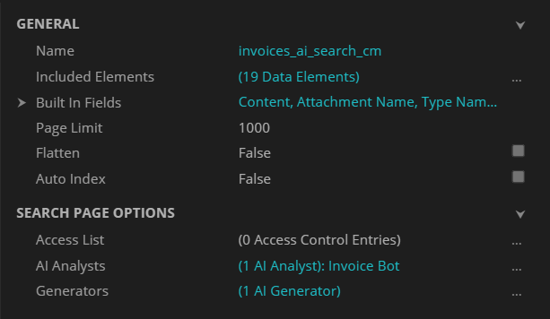
Document Search and Retrieval
Indexing Behavior
Indexing Behavior’s property grid
Before you can search for documents, you must index them.
Setting an “Indexing Behavior” on a Content Model makes all child Document Types indexable
Extracted Data Elements can be added to the indexed fields for each document.
Access to the index can be locked down with ACLs.
Can select AI Analysts and set up “AI Generators” usable from the Search page.
BE AWARE: After adding the Indexing behavior, you will need to create the search index from Grooper.
To do this, right click the Content Model and select “Search > Create Search Index.
Notes:
Alt-click to select all elements under a selected element.

Slide 33
Document Search and Retrieval
Ways to index documents
Most manual
Right-click one or more documents and using the "Add to Index" command
FYI: Documents may also be removed using the "Remove from Index" command.
Right-click the indexable Content Model and submit an “Indexing Job” using the “Search > Submit Indexing Job”
Adds any newly classified documents, updates existing documents whose fields have changed, and removes deleted documents from the index.
An Activity Processing service will need to be running to pick up the job.
Use an Execute activity in a Batch Process to apply the "Add to Index" command to all documents in a Batch.
Running the Grooper Indexing Service to index documents automatically in the background.
The Indexing Service periodically polls the Grooper database to see if the index needs updating and, it does, submits an “Indexing Job”.
An Activity Processing service will need to be running to pick up the job.
Most automated

Slide 34
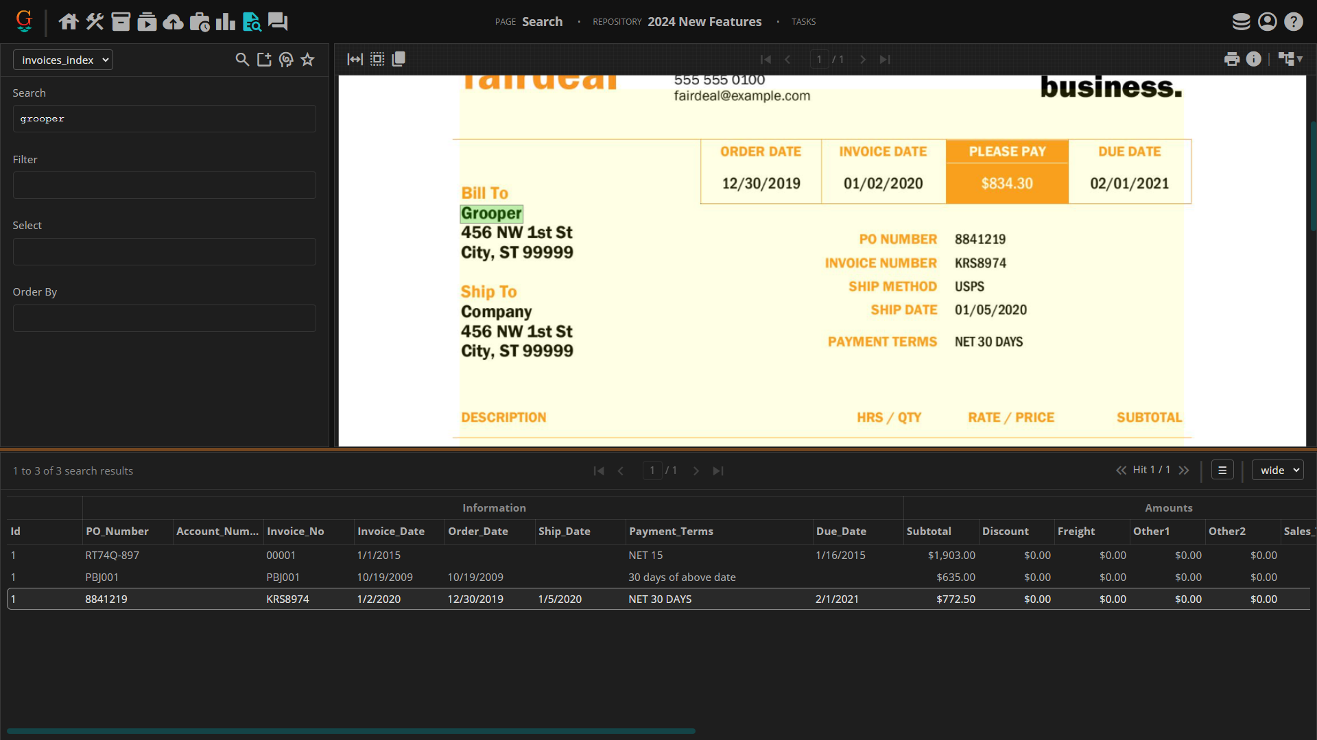
Document Search and Retrieval
The Search Page
Full text search is supported for the documents’ text content and single-instance field values.
Search hits are highlighted.
Users can save favorited queries.
Fields can be displayed in a variety of ways.
Notes:
Allows users to search for indexed documents

Slide 35
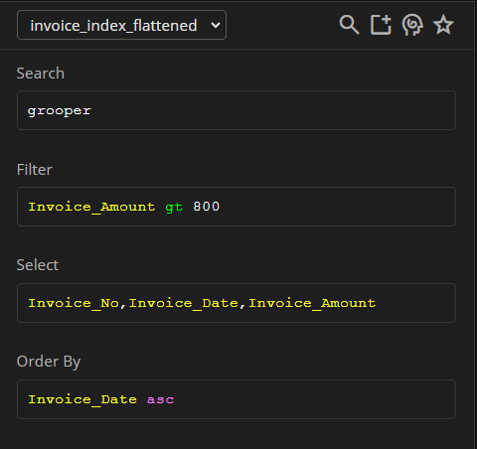
Document Search and Retrieval
Search criteria
Four parts to a search query:
Search: Uses Lucene query syntax to perform full text searches
FYI: Wildcards and fuzzy searching are supported
Filter: Users OData filter syntax to filter results by comparing field values
Select: Use to only display certain fields in result list.
Order By: Sorts result list by selected field(s)
Code completion will assist users when editing queries. Users can also use the “AI Query Helper” to use an LLM to help craft a query from a natural language prompt.
Notes:
Allows users to search for indexed documents

Slide 36
Document Search and Retrieval
Search page commands: Document commands
Commands executed from the Search page offer new ways to interact with documents. There are “document commands” and “result set commands.”
The following “document commands” are executed by right-clicking a document in the result list:
Copy Link – Copies a link to the document which will open that document in a Review Viewer.
Go to Document – Navigates users with Design page permissions to that document in the Grooper node tree.
Review Document – Opens the document in a Review Viewer.

Slide 37
Document Search and Retrieval
Result set commands
These commands can be applied to the entire result set or a selection from the result set.
Create Batch Creates a Batch from the result set and submits an Import Job
Submit Job For on-demand activity processing. Submits a processing job for documents in the result set.
Analyst Chat Select an AI Analyst to start a chat session with the result set.
Download Download a document, generated from the result set. Options are:
Download PDF – Generates a single bookmarked PDF with optional hit highlights.
Download ZIP – Generates a ZIP file containing each document in the result set.
Download CSV – Generates a CSV file from the result set’s data fields.
Download Custom – Generates a custom document using an “AI Generator”

Slide 38
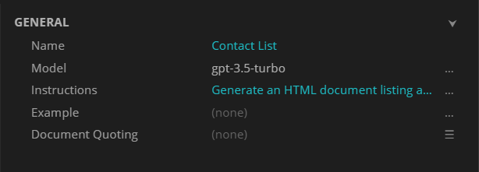
Document Search and Retrieval
AI Generators
Example AI Generator configuration
AI Generators create documents using prompts sent to an LLM chatbot.
They are configured on the Indexing Behavior.
Can use full text data or extracted data to generate the document.
Examples include:
Simple report generation
Language translation
Document/Batch summarization
Notes:
Ex: An HTML report categorizing line items
Ex: A contact list for any listed party

Slide 39
Document Search and Retrieval
Search page uses
Current use cases include:
A new way to start Batch processing
Bring in content through traditional import mechanisms. Get text off them. Do some basic indexing. Use a search query to more narrowly select documents you want
An efficient mechanism to find a document set and submit set specific tasks
Need to re-extract all documents of a certain type in your repo? Easily done from the Search page.
Ad-hoc research
BIS has used Search to locate example documents for new Document Types in a recent project
Allows users to keep content in Grooper long term
Find content in a large Grooper Repository with hundreds or thousands of documents
Notes:
We are in new territory with the Search page. Grooper has never had a robust search and retrieval mechanism. We will be looking for more and more ways to use the Search page as Grooper 2024 matures.
Importantly it lays the groundwork for Grooper as a document repository.

Slide 40
New and Improved Functionality
Committed to web development
WINDOWS CLIENT REMOVAL
GROOPER COMMAND CONSOLE
UI IMPROVEMENTS
EFFICIENCY IMPROVEMENTS
LLM Integrations
AI EXTRACT
CLAUSE DETECTION
AI ANALYSTS &
DOCUMENT CHAT
Document search and retrieval
AI SEARCH INTEGRATION
THE SEARCH PAGE
NEW WAYS TO PROCESS CONTENT
Notes:
Click 1 – All topics

